Slide 1


Slide 2
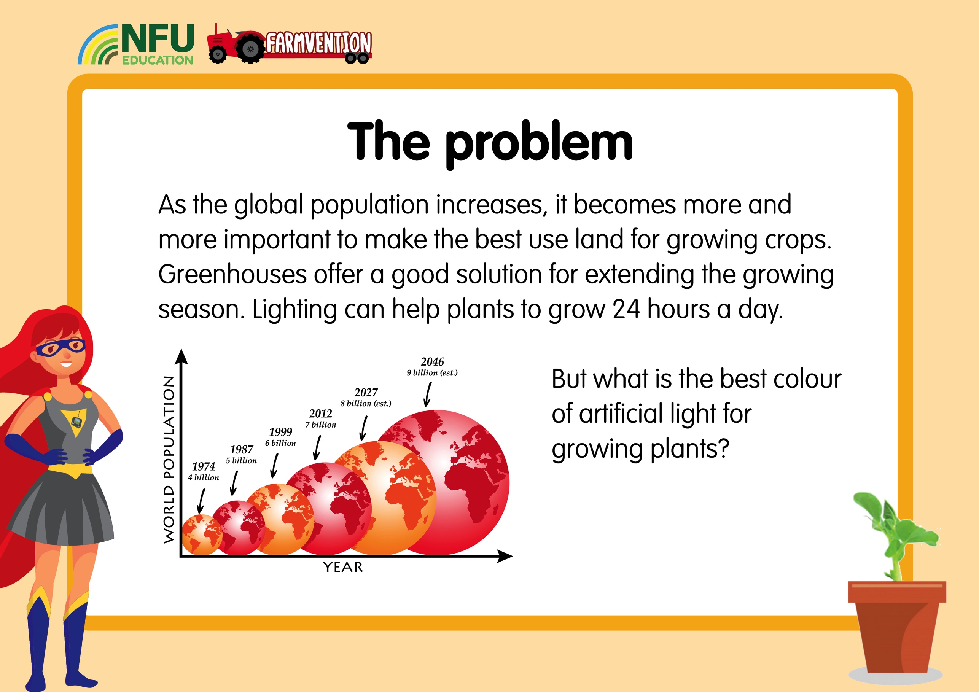

Slide 3


Slide 4
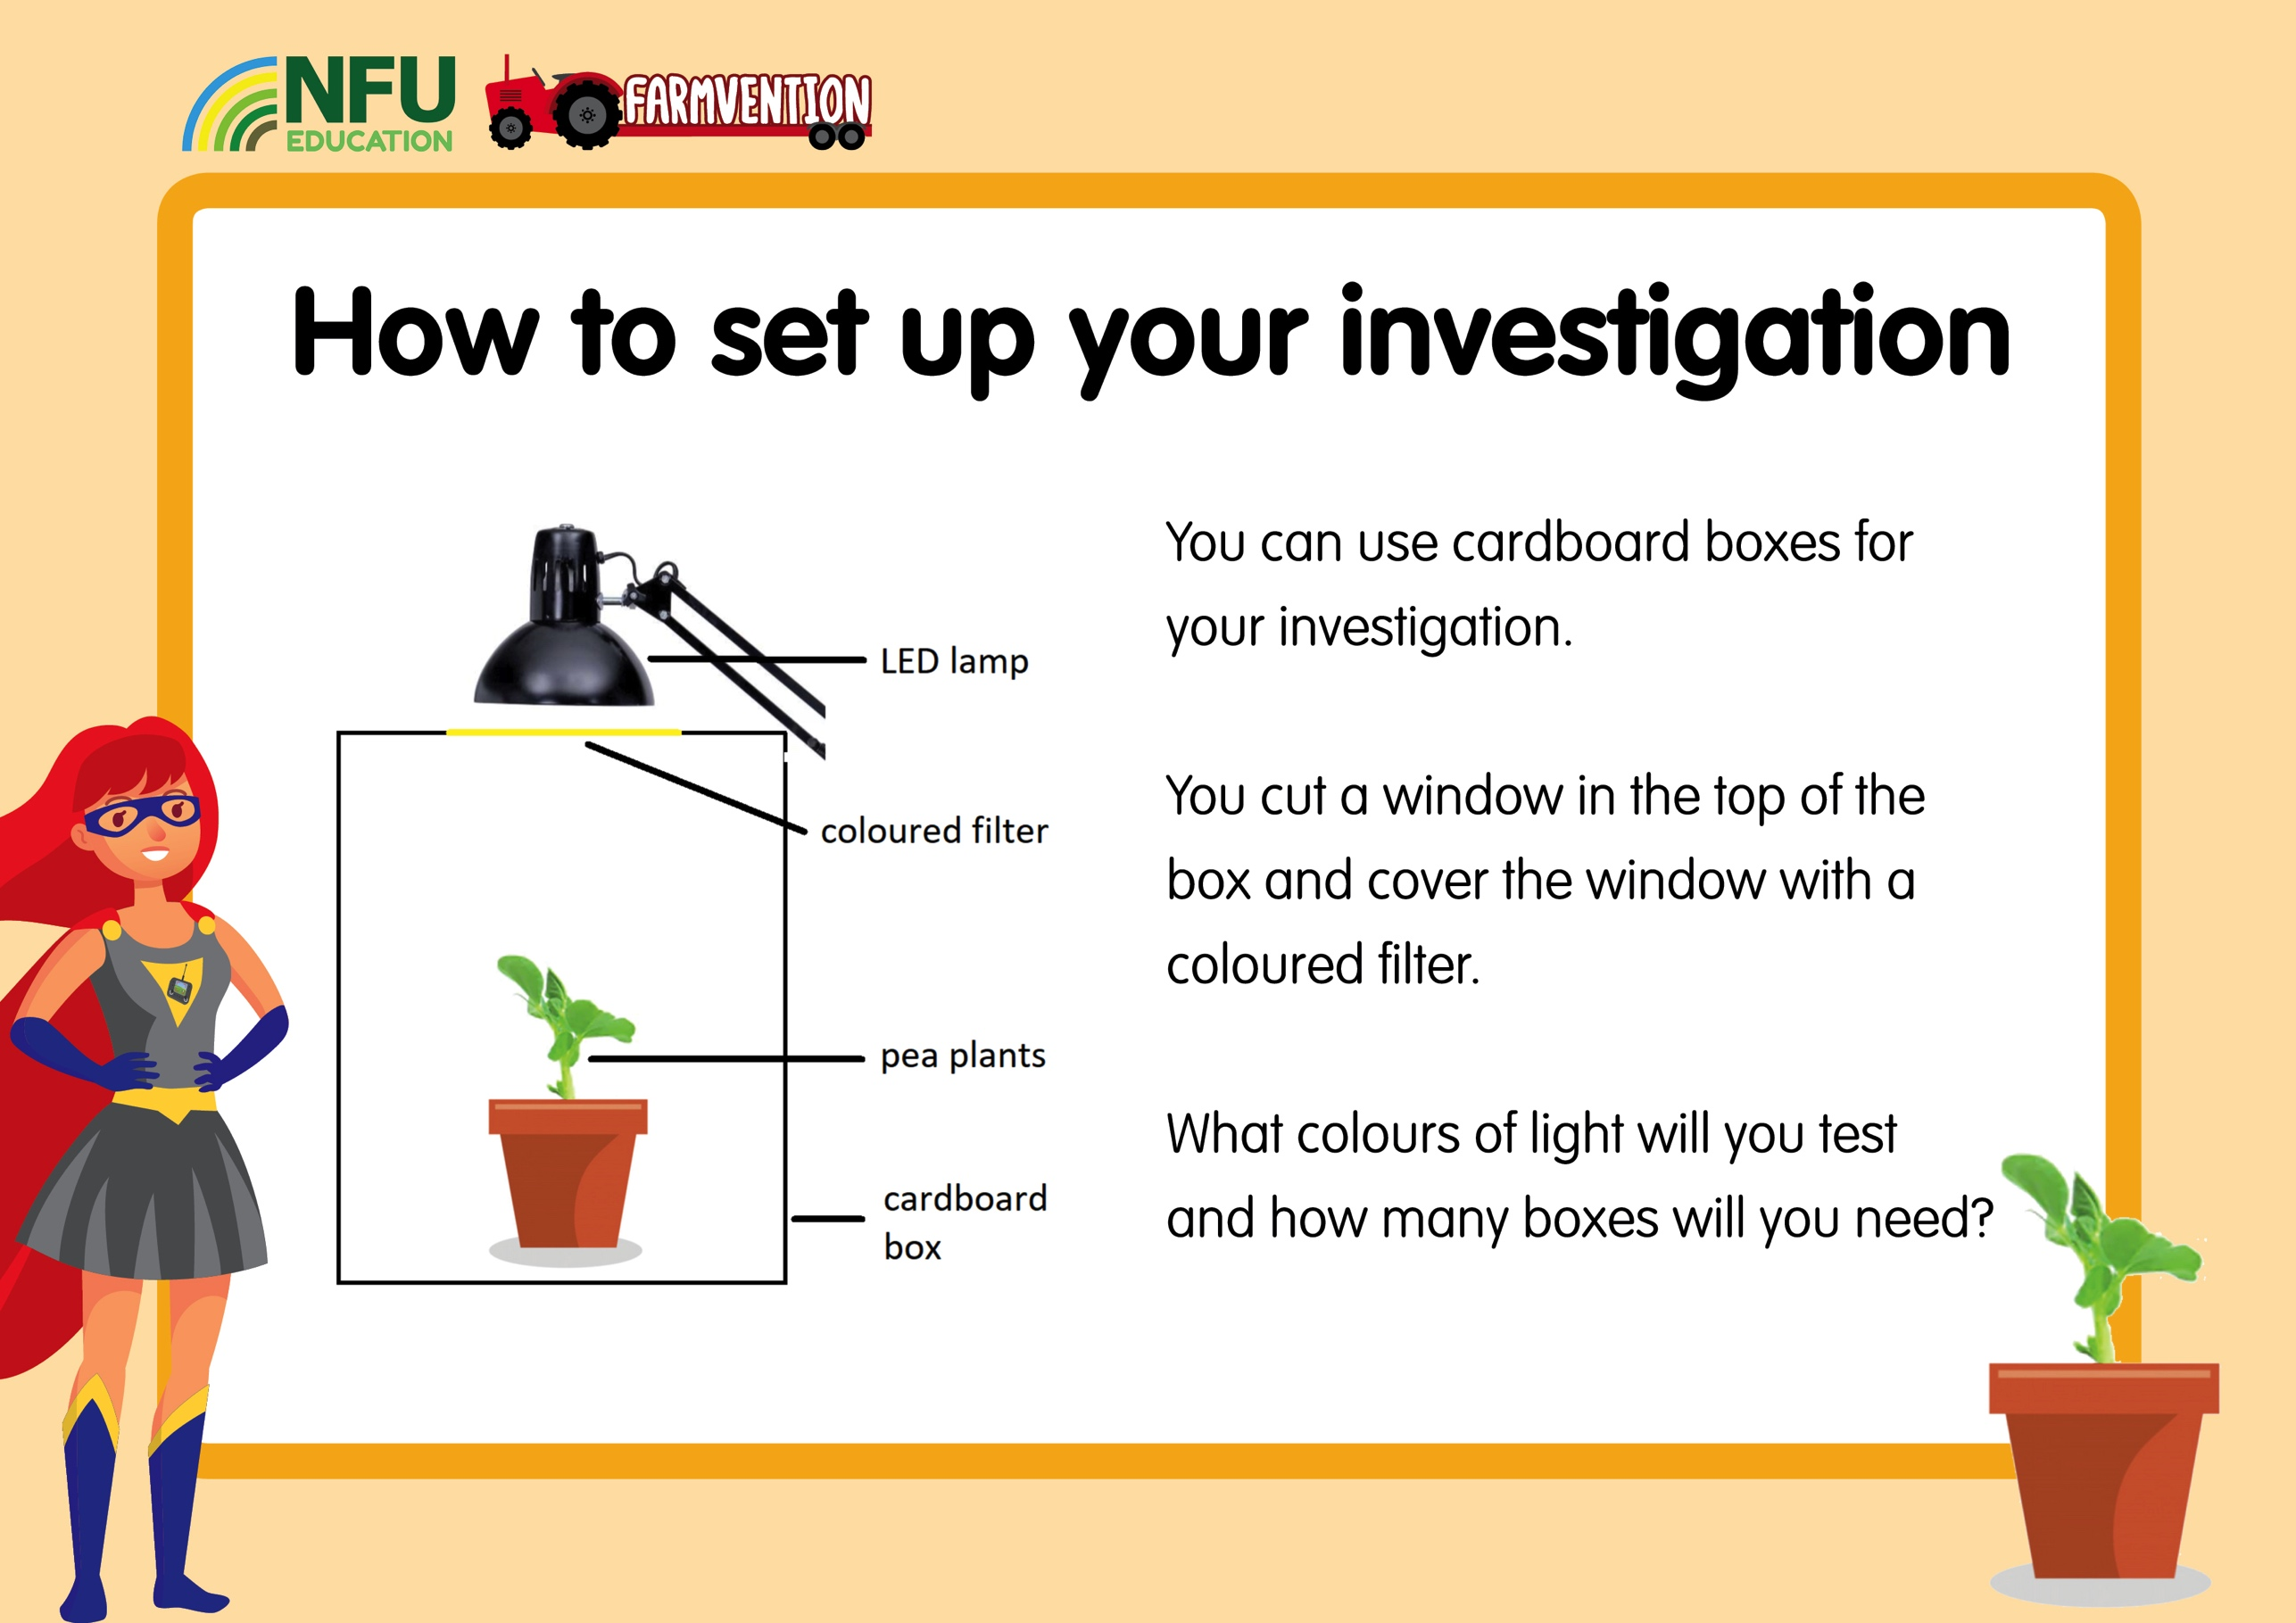

Slide 5
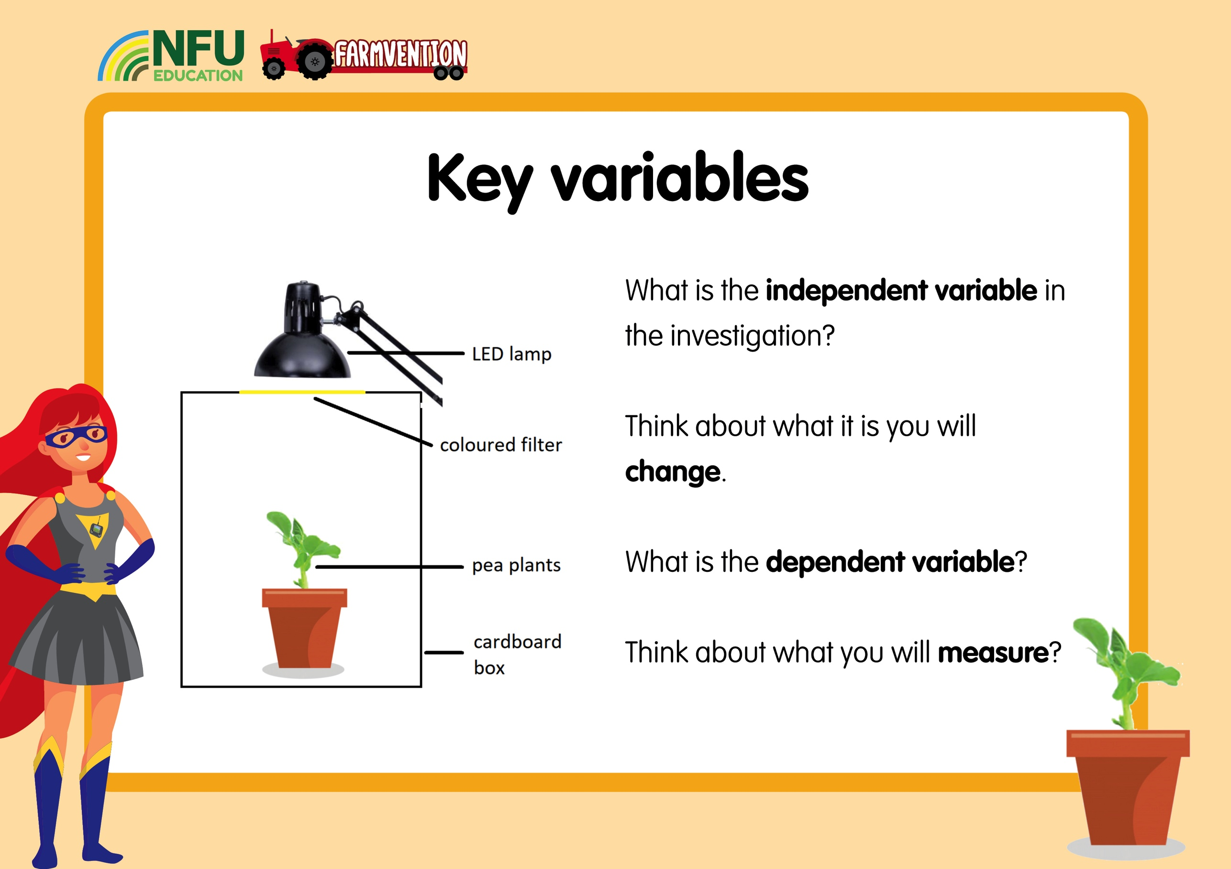

Slide 6

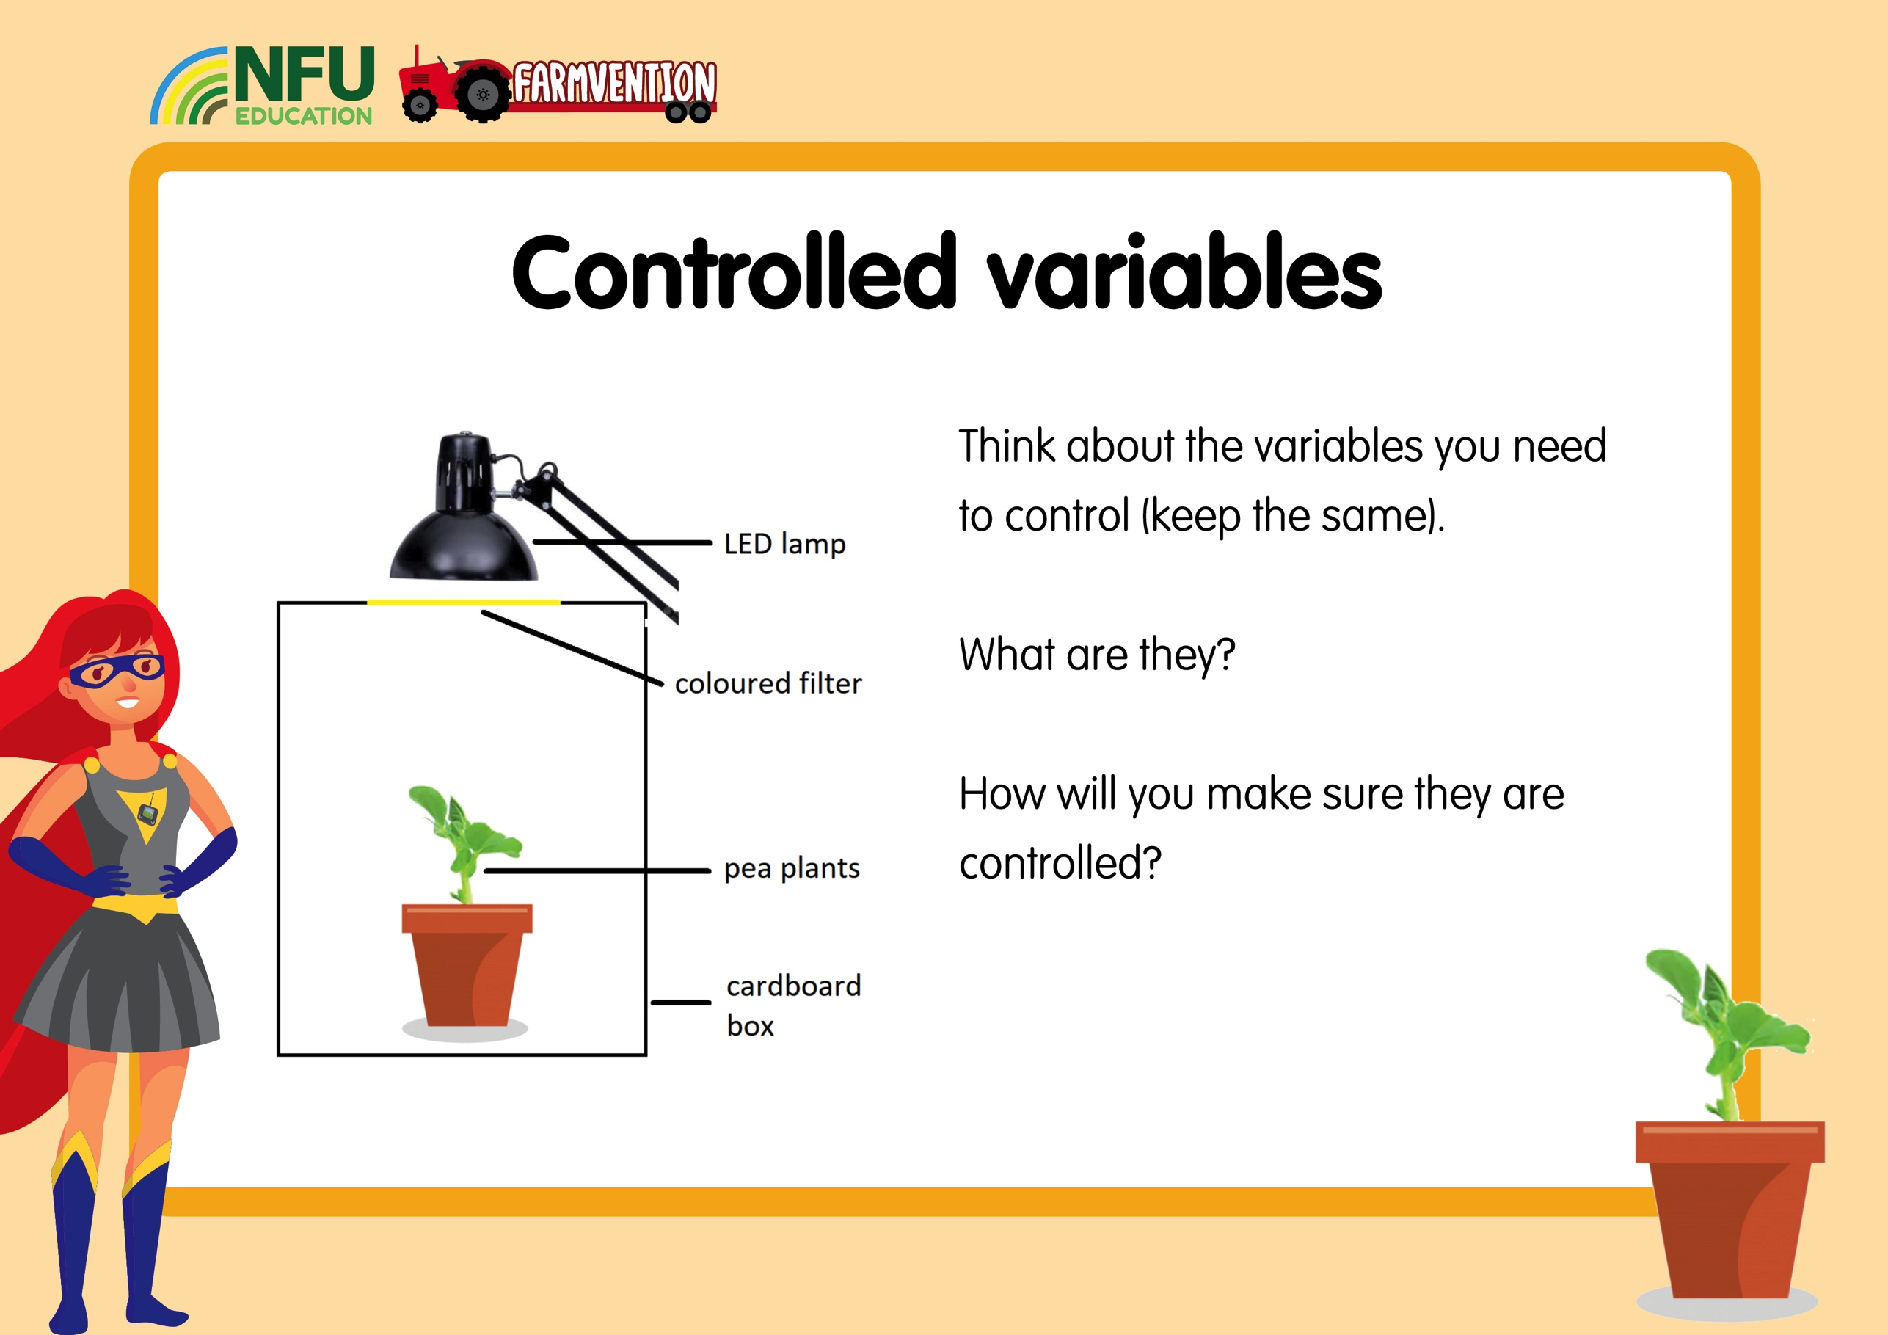

Slide 7


Slide 8


Slide 9


Slide 10


Slide 11

www.farmvention.com

